Slide 1
reV Demo for RPM Clusters
Katy Waechter, Travis Williams

Slide 2

The Renewable Energy Potential (V) Model
reV is a geospatial platform for assessing system performance, available capacity, distance to transmission, and total costs for potential solar and wind energy deployment at regional to continental scales.
System Performance & Costs
Distance to Transmission
Available Capacity
Notes:
The reV model is a platform for assessing renewable energy potential and its geospatial intersection with grid infrastructure and land use characteristics.

Slide 3
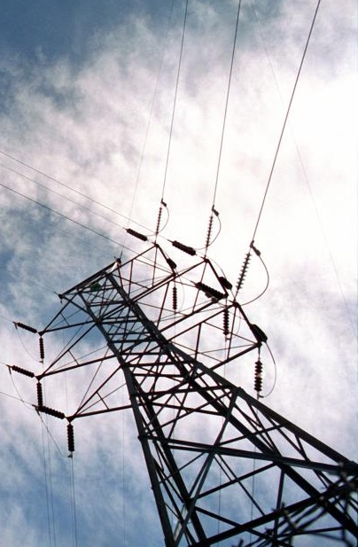
Answering Big Questions for Energy Planning
What are the land-use requirements and impacts of increasing levels of renewable energy deployment?
What are the transmission and integration costs of renewable energy deployment?
What are the impacts of inter-annual resource variability on renewable energy cost and performance?
Notes:
Coupling methodologies for maintaining spatiotemporal characteristics of variable renewable energy in spatially course capacity expansion and nodal-based production cost models

Slide 4
Integral Part of a Modeling Community

Slide 5

Model Coupling
reV produces data for a diverse set of models, each with varying degrees of spatial and temporal requirements

Slide 6
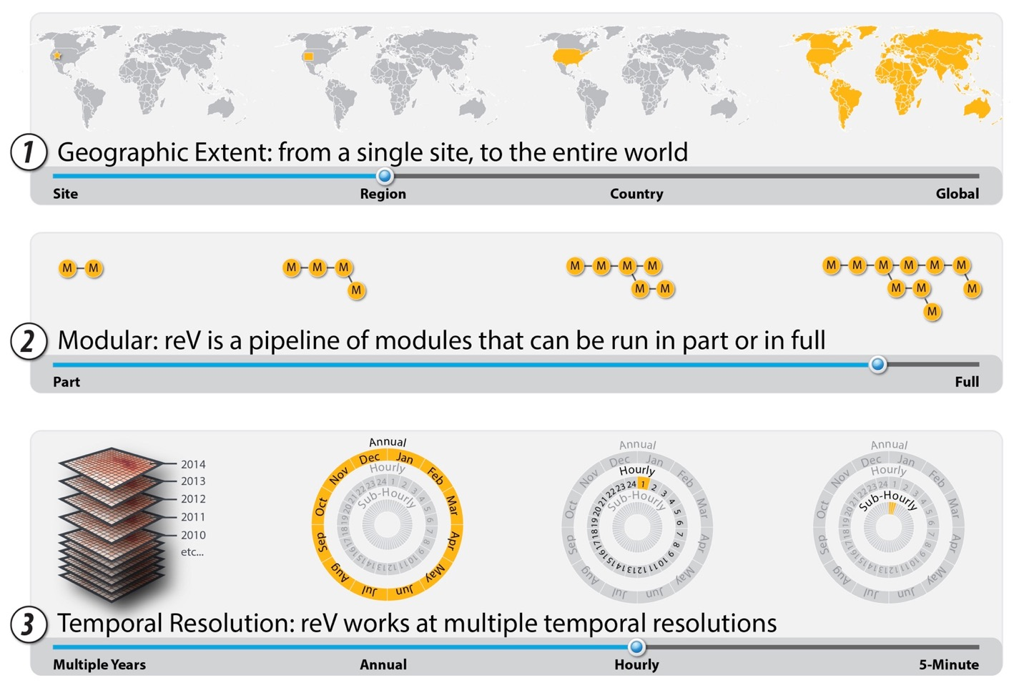
reV is Flexible in Scope and Scale

Slide 7
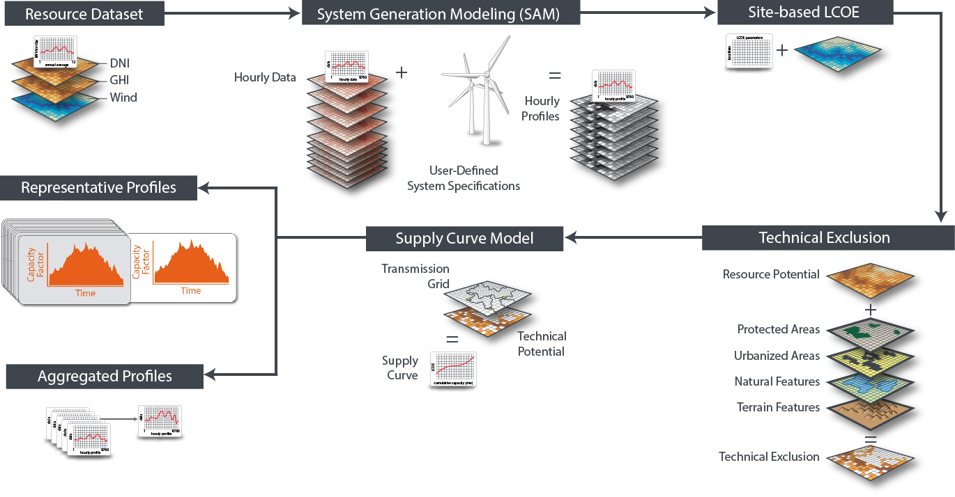
reV Model Diagram
Capacity Expansion Models

Slide 8

National Solar Radiation Database (NSRDB)
Temporal Range: 1998-2020
Temporal Interval: 5-minute for select ranges, 30-minute
Spatial Resolution: nominal 4 km
Spatial Extent: Western Hemisphere

Slide 9
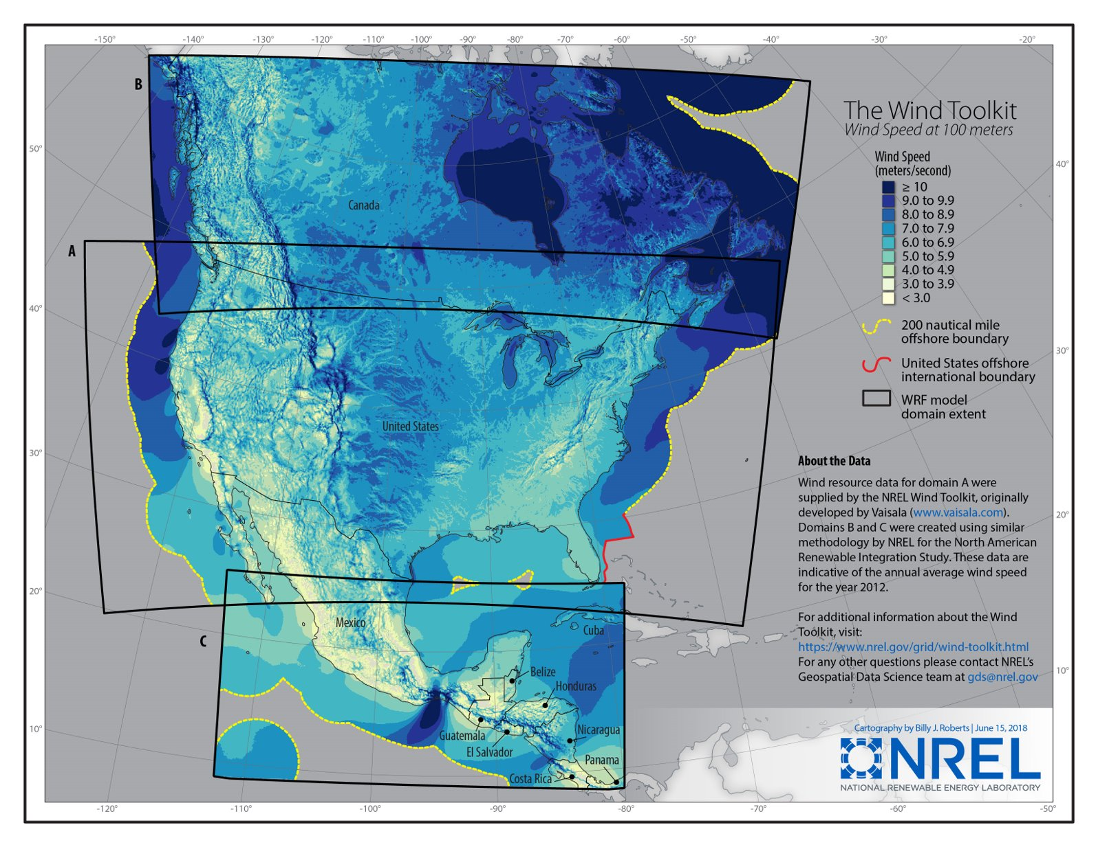
WIND Toolkit
Temporal Range: 2007-2014
Temporal Interval: 5-minute
Spatial Resolution: nominal 2 km
Spatial Extent: North America (land and offshore)

Slide 10
Accessing NSRDB and WIND Toolkit
Equinor users can access NSRDB and WIND Toolkit resource data via:
NREL Developer API
Requires sign up; rate limited
Data transfer via HSDS
Direct download from NREL Sharepoint

Slide 11
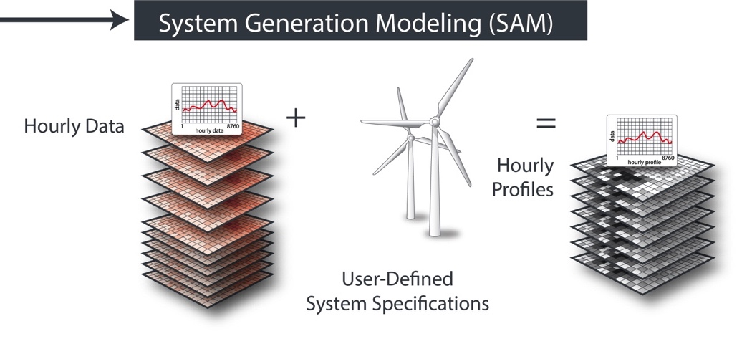
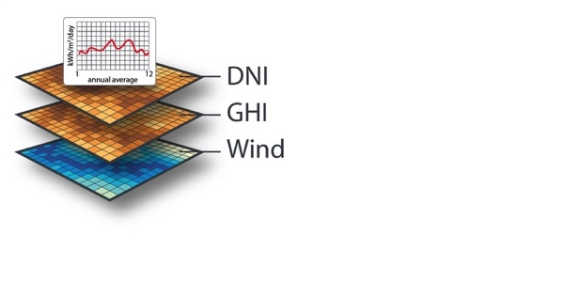
Generation Potential
reV couples with the System Advisor Model (SAM) to estimate time series capacity factors at the resource data resolution (e.g., 5-min, hourly)
Resource Data set
System Performance Modeling

Slide 12
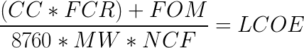
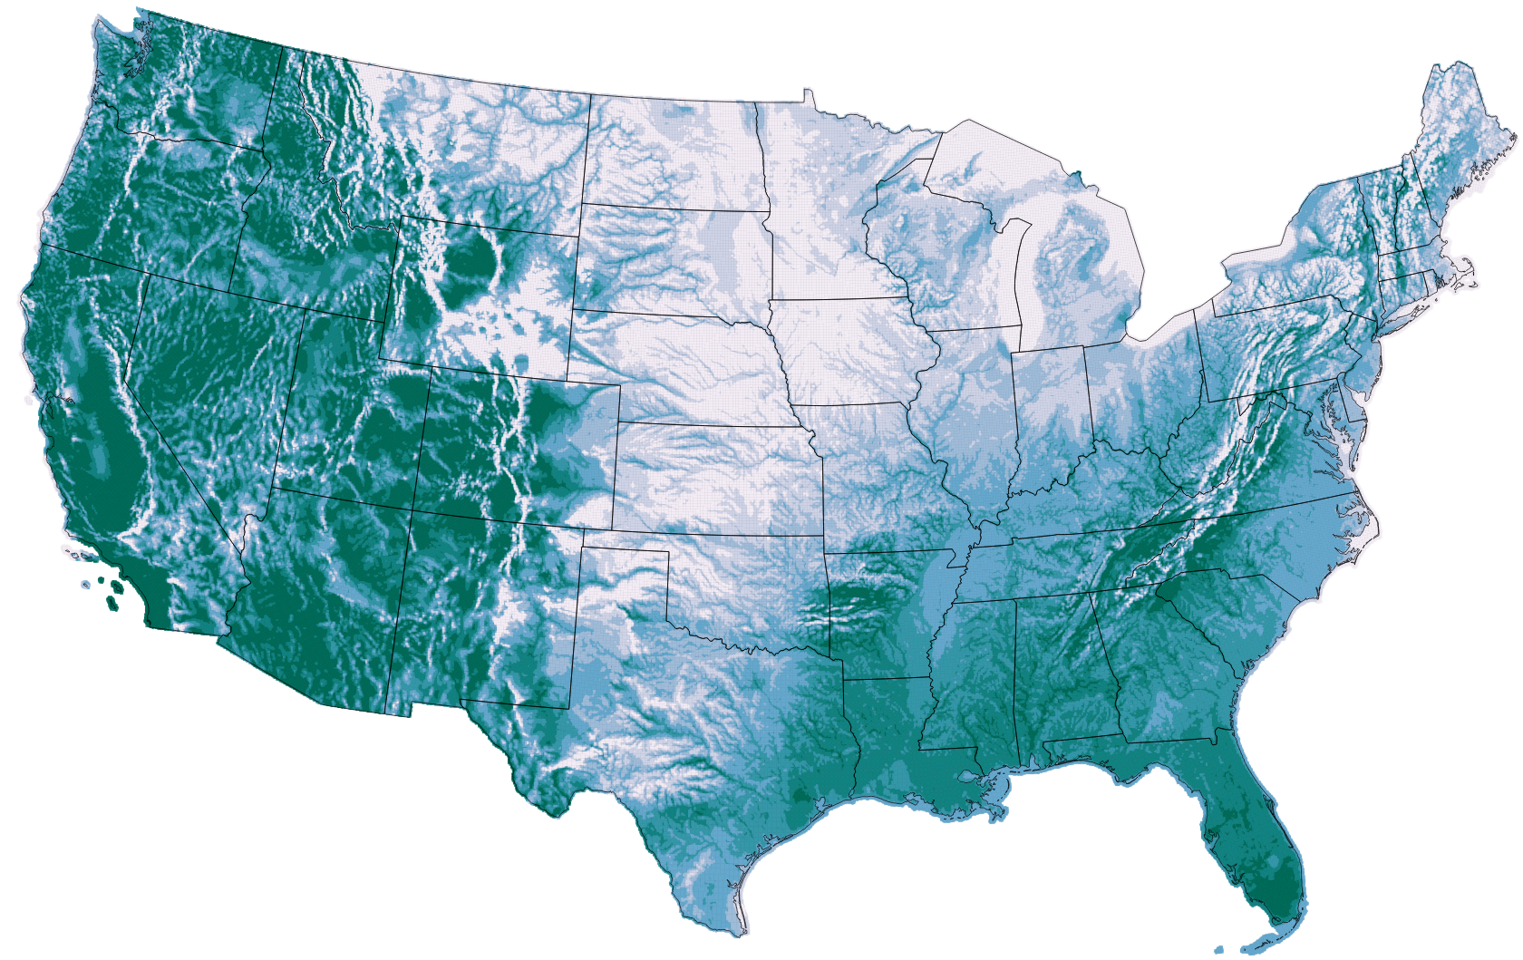
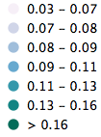
Calculating Site-Based LCOE
CC: Capital Cost ($)
FCR: Fixed Charge Rate
FOM: Fixed Operations and Maintenance ($-Annually)
MW: System Size
NCF: Net Capacity Factor
LCOE cents/kWh

Slide 13
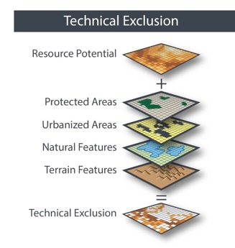
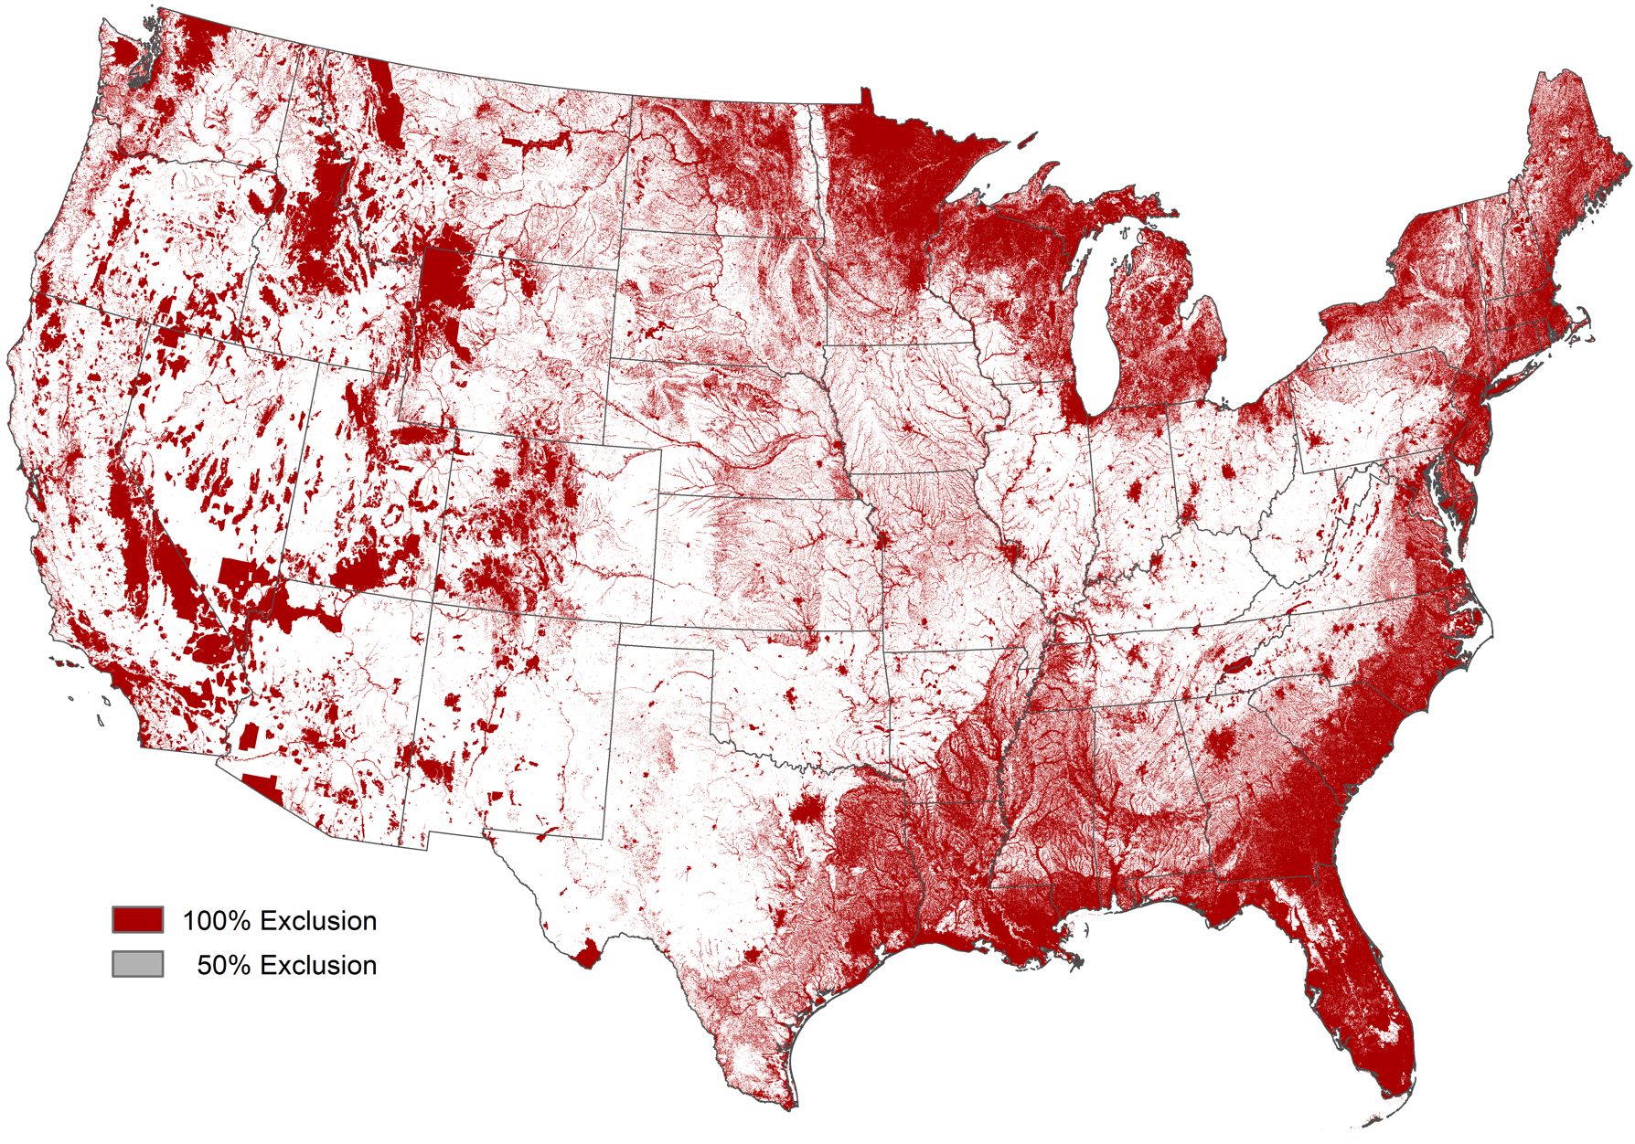
Technical Exclusions
Exclusions provide a means to model siting considerations and resulting supply impacts.
Exclusions typically represent sociopolitical, ecological, and technical constraints.

Slide 14

Solar and Wind Potential
PV and Wind potential
Wind and solar potential is often assessed in terms of geographic (or resource), technical, and economic potential. The results of this analysis characterize the developable quantity, quality, and cost of wind and solar resources that can be sorted to represent a supply curve.
Wind potential only
PV potential only

Slide 15


Potential to Power Plants
Discrete PV power plant
Each wind farm and PV plant quantifies:
Multi-year mean capacity factor (%)
LCOE ($/MWh)
Interconnection costs ($/MWh)
Available land (sq.km)
Potential capacity (MW)
The technical potential analysis is evaluated at 90m spatial resolution, but aggregated up to discrete power plants for supply curve analysis
Discrete wind farm

Slide 16
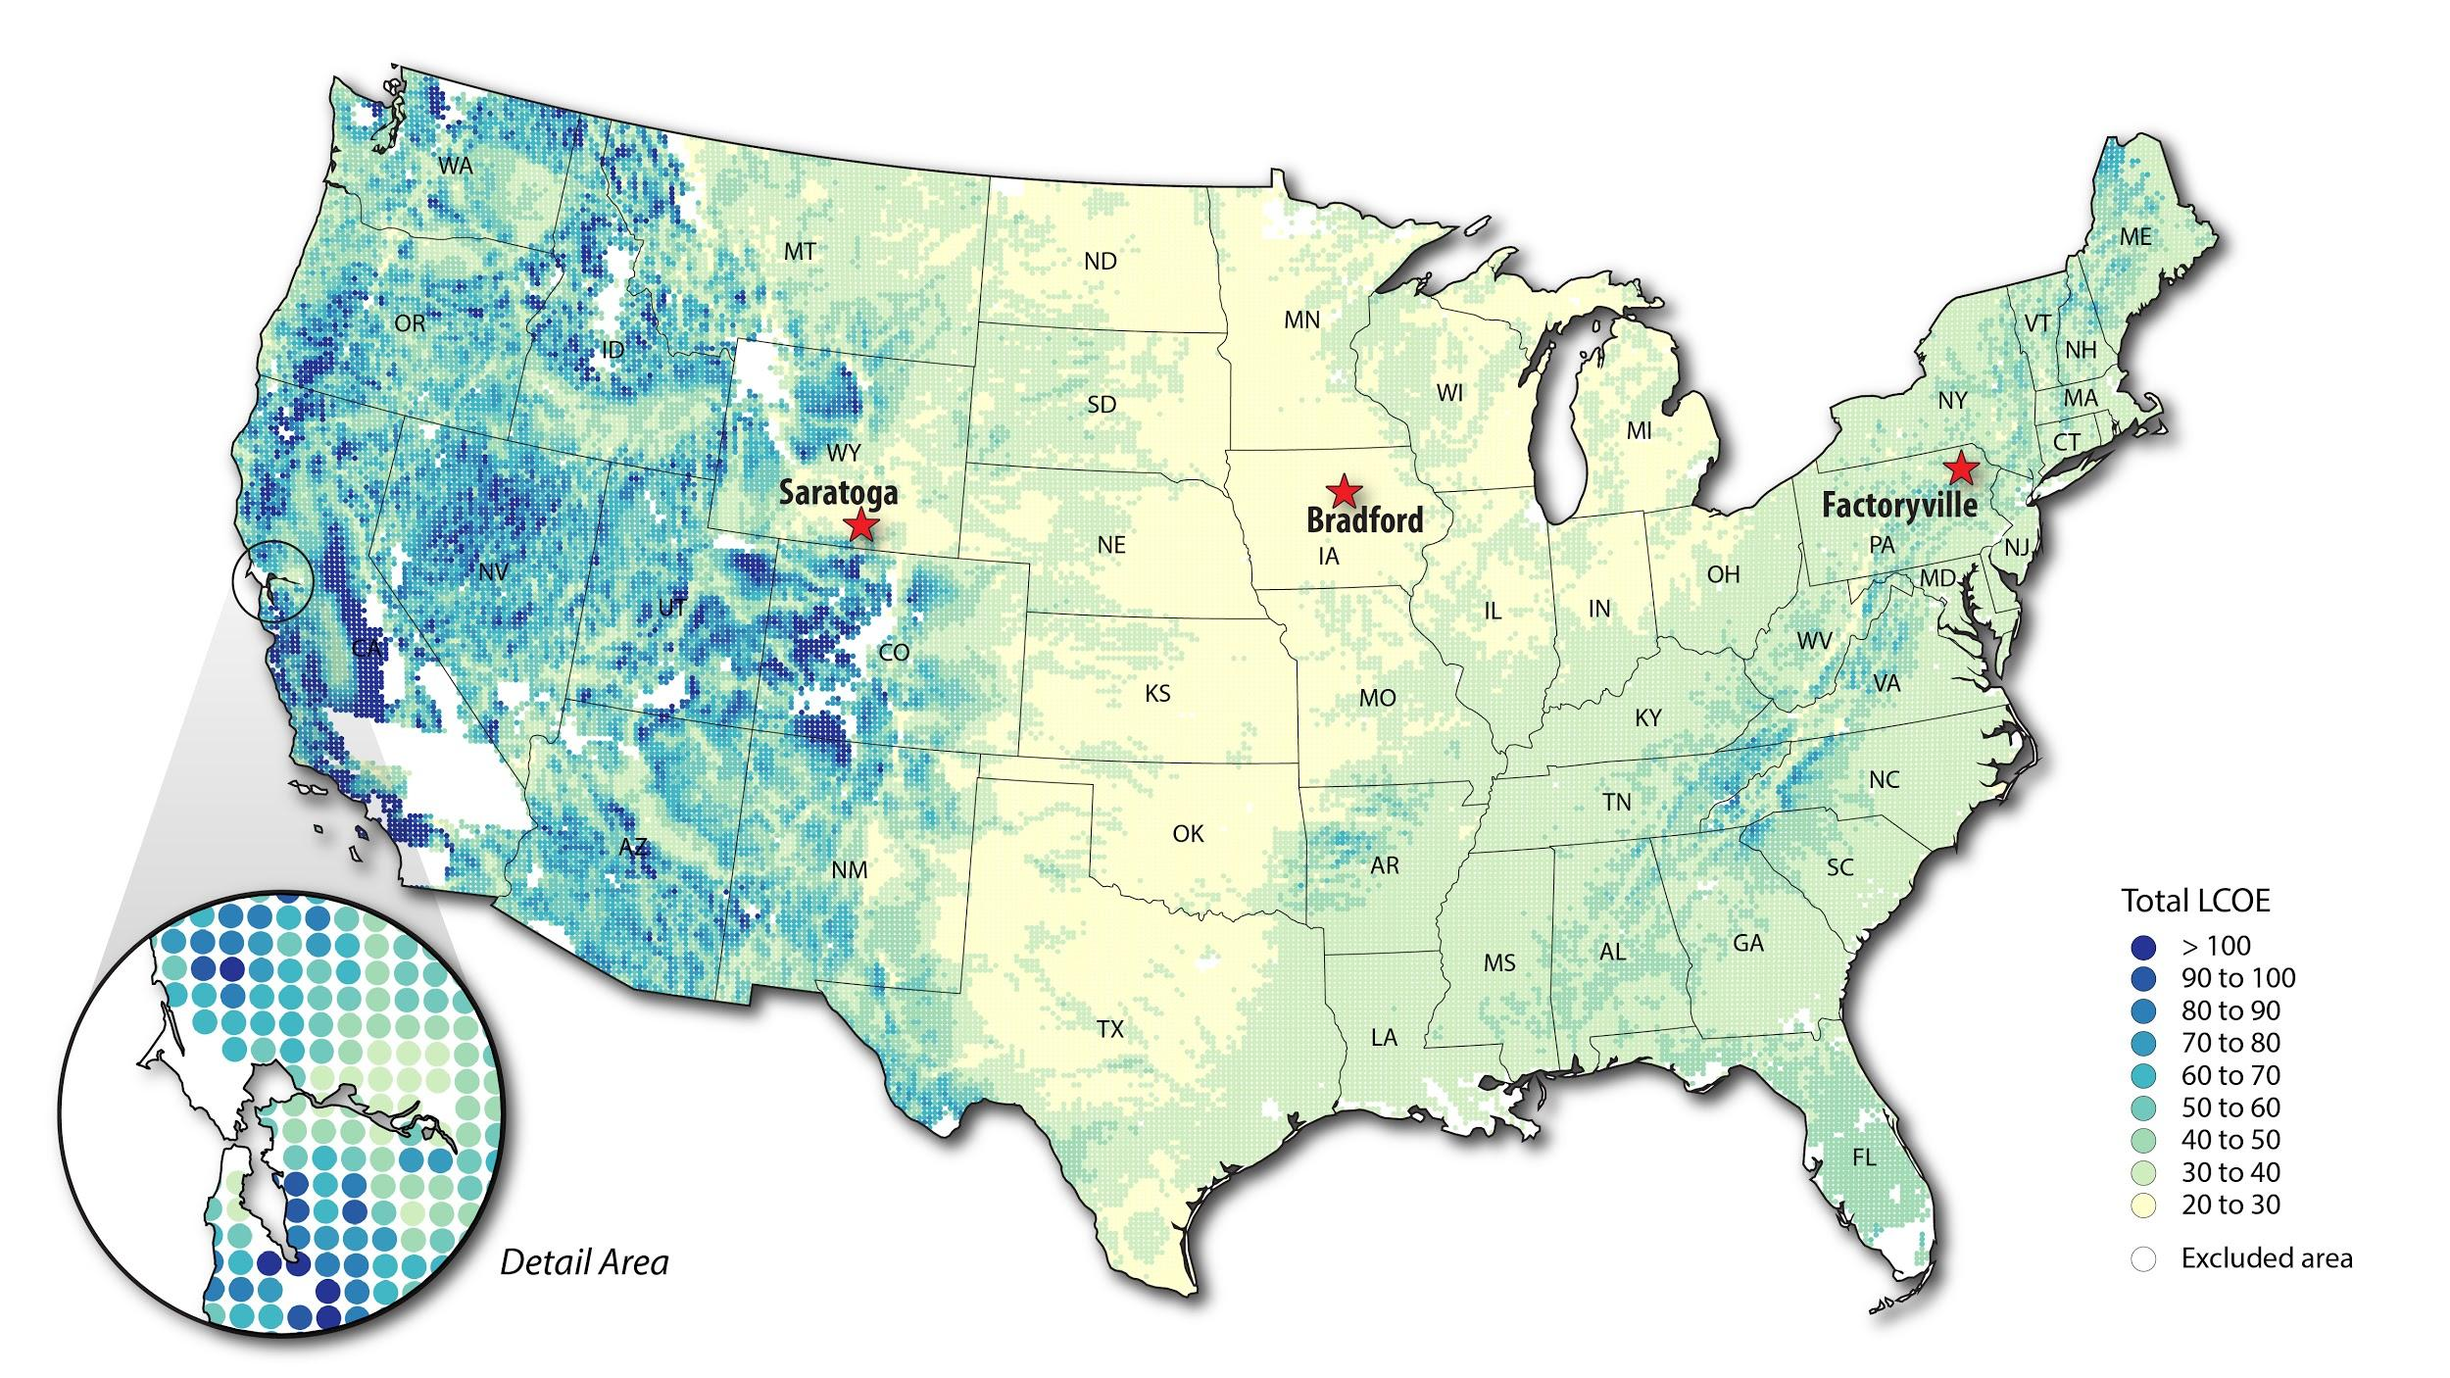
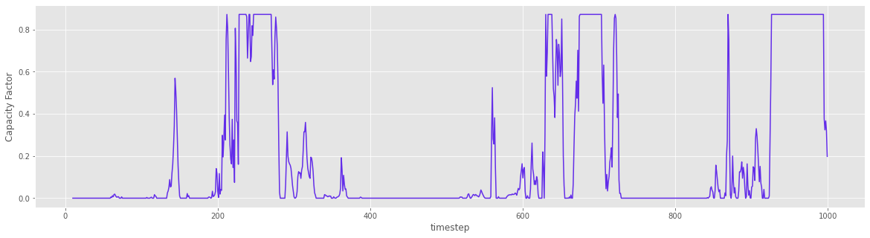
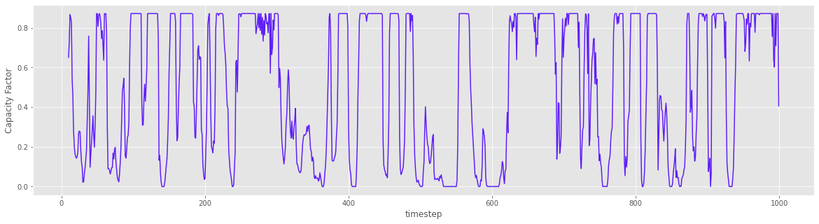
Each site has an associated capacity factor profile

Slide 17
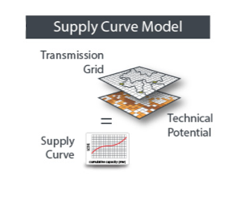
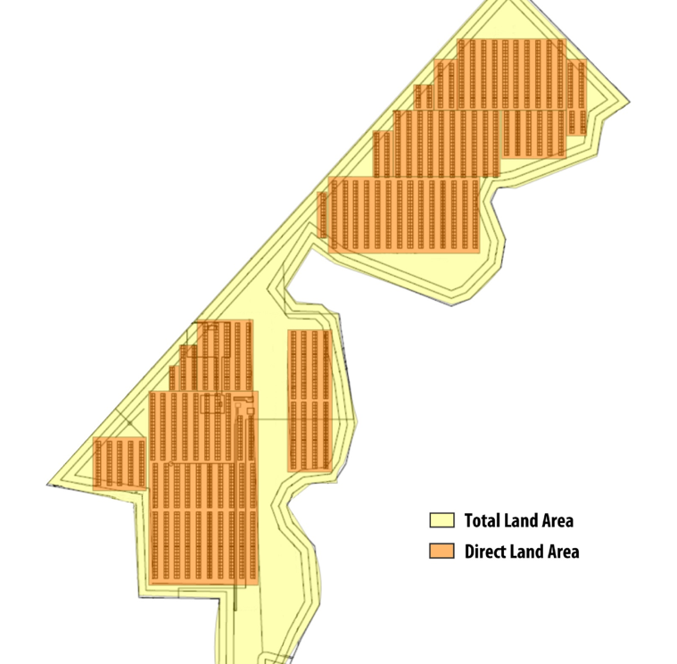
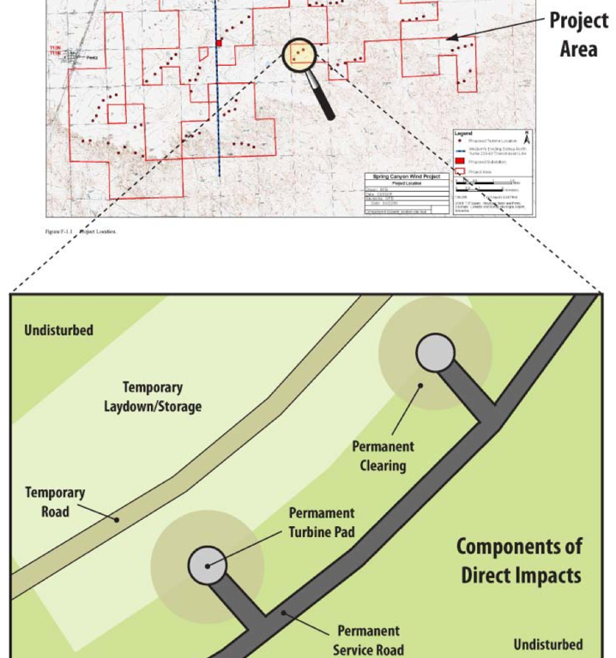
Aggregating for Supply Curve: Technical Potential
System generation and performance determined using solar and wind weather data
Annual Technical Potential=
Available area (km²) * Capacity Density (MW/km²) * Mean Net Capacity Factor * 8760 hours
Determined through geographic exclusions and aggregating to discrete power plants
PV Plant
Wind Plant
Typically 28-36 MW/km² Fixed-Tilt PV
Typically 3-5 MW/km² Wind Plant

Slide 18
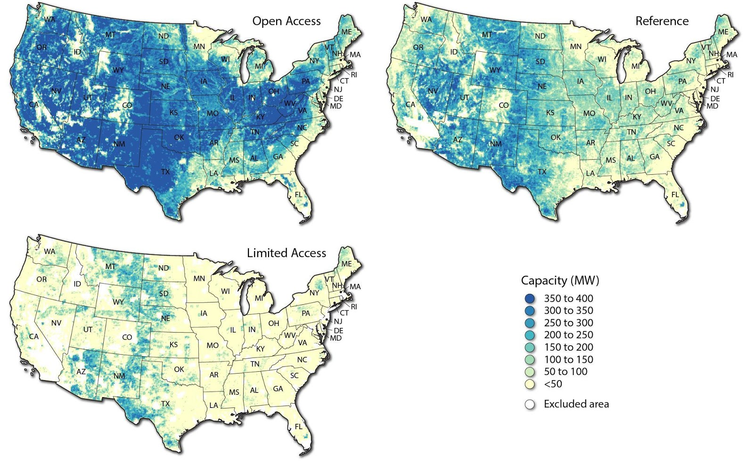
Wind Scenarios
Scenario | Wind Capacity
All Land | 23 TW
Open Access | 15 TW
Reference | 7.8 TW
Limited Access | 2.3 TW

Slide 19
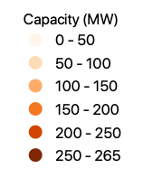
Solar Scenarios
Scenario | Solar Capacity
All Land | 248 TW
Open Access | 179 TW
Reference | 104 TW
Limited Access | 29 TW

Slide 20
Resources
Operation and set up:
GitHub page: https://nrel.github.io/reV
reVx.RPM tools:
GitHub page: https://nrel.github.io/reVX/_cli/reV-rpm.html
GitHub repository: https://github.com/NREL/reVX
Reference:
GitHub repository: https://github.com/NREL/reV
Tutorial (in development):
reV-tutorial: https://github.com/WilliamsTravis/reV-tutorial
Will be merged into official reV repository in February

Slide 21

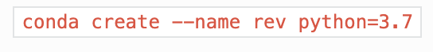
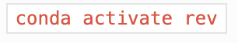
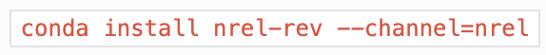
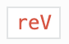
Set Up
Use a virtual environment to manage Python packages for reV
1. Create a new environment
2. Activate the new environment
3. Install reV from the NREL channel
4. Verify installation success
Notes:
reV, built in Python, is a complex, extensible, and modular framework developed on NREL’s flagship high performance computer, Eagle.

Slide 22
Compute Environment
reV can run in 3 environments:
Eagle
AWS
Local machine
* reV-gen and reV-econ modules only

Slide 23
reV Model

Slide 24
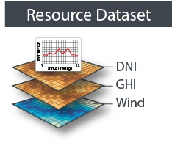
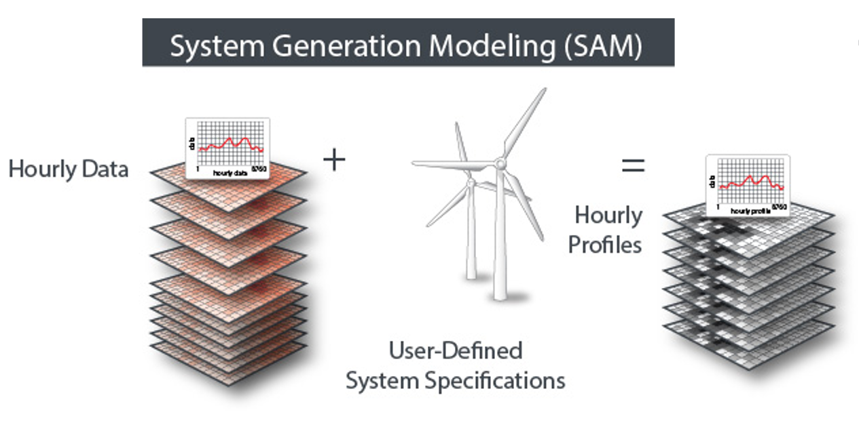
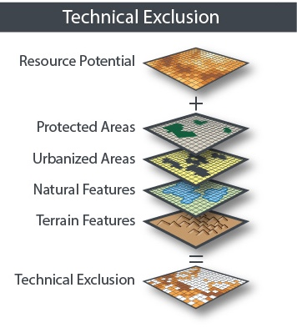
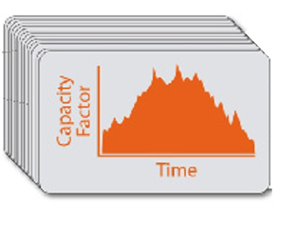
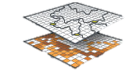
RPM Clusters Model
Cluster Profiles
Clusters

Slide 25
File Inputs
Each reV module has variable input files and associated requirements.
The following reV modules were used in creation of RPM clusters and cluster profiles for the NYISO analysis:
Generation
Collect
Batch
Notes:
Not covering Econ, Supply-curve, Representative-profiles

Slide 26
File Inputs -- Generation
The generation module batches SAM across millions of resource pixels, allowing for multiple system configurations.
Currently supports pvwatts7, windpower, csp SAM modules
gen_gid | config | res_gid
Site index of generation file; not necessarily same as res_gid | Nominative value used in config_sam.json | Site index of resource file
Project points (.csv)
Configurations:
config_gen.json : settings for generation module
config_sam.json : SAM generator configurations for those referenced in project_points.csv/config

Slide 27
File Inputs -- Collect
For runs on in compute environments where computations are distributed across multiple nodes, node generation output files need to be collected into 1 generation file. Subset generation files are divided based on a range of site indices (correspond to project_points.csv).
Configurations:
config_collect.json : settings for gathering subset generation files

Slide 28
File Inputs -- Batch
In situations where you need to compute multiple runs for the same locations, batch module is used to streamline model runs to create input configuration files and execute runs based on those configuration files.
Configurations:
config_batch.json : configuration for all runs to batch; can be manually set or programmatically set (not part of existing reV pipeline)
May cross-reference other config files (config_gen.json, config_sam.json)

Slide 29
File Inputs -- Clusters
Generation h5 file:
Technical exclusions h5 file:
Configurations:
Count of clusters per each balancing area
config_aggregation.json : configuration for aggregation to supply curve points; used to create a dictionary of what technical exclusion layers to exclude/include/weight

Slide 30
reVX.RPM -- Clusters
reVX, the Renewable Energy Potential(V) Exchange Tool, provides a set of tools to extract data from reV model outputs and interface with RPM. Users can install reVX similarly to reV by following instructions on the reVX Github page (https://nrel.github.io/reVX/index.html).

Slide 31
Running reV
reV is mostly commonly run in the command line interface (CLI), regardless of compute environment. Individual modules can be run by calling them as arguments with corresponding config file(s). However, it’s preferred to use full pipeline execution to document model runs.
Configuration:
config_pipeline.json : configuration for all modules to be executed for a given run set
Must cross-reference other config files (config_gen.json, config_sam.json, config_collect.json, config_aggregation.json, …)

Slide 32
Examples of reV CLI Commands
(base) user@users-computer:~/rev_folder$ conda activate revenv
(revenv) user@users-computer:~/rev_folder$ reV-gen from-config –c config_gen.json
(revenv) user@users-computer:~/rev_folder$ reV-collect from-config –c config_collect.json
(revenv) user@users-computer:~/rev_folder$ reV –c config_batch.json batch --dry-run –monitor-background
(revenv) user@users-computer:~/rev_folder$ reV –c config_batch.json batch --monitor_background --logdir ./logs
(revenv) user@users-computer:~/rev_folder$ reV-pipeline from-config –c config_pipeline.json
(revenv) user@users-computer:~/rev_folder$ reV –c config_pipeline.json pipeline

Slide 33
File Inputs -- Clusters
Generation h5 file: capacity factor profile dataset (n, 8760)
Technical exclusions h5 file: build list of reV-grid indices to exclude/include/weight in evaluation of developable areas
RPM meta table (.csv): mapping of project points to balancing area and count of desired RPM Clusters per balancing area (varies by technology)
Configurations:
parameters.json: concatenates set up info for RPM Clusters and configuration for aggregation (from config_aggregation.json); used to create a dictionary of what technical exclusion layers to exclude/include/weight

Slide 34
File Inputs – Cluster Profiles
Generation h5 file: capacity factor profile dataset (n, 8760)
Technical exclusions h5 file : build list of reV-grid indices to exclude/include/weight in evaluation of developable areas
Configurations:
Clusters table (.csv)
config_aggregation.json : configuration for aggregation to supply curve points; used to create a dictionary of what technical exclusion layers to exclude/include/weight

Slide 35
Running RPM Clusters & Profiles
Scripts used to call reVX.RPM tools are available in NREL Sharepoint:
run_cluster_all.sh : bash script to kick off clustering.py that utilizes reVX.RPM.ClsuterManager.run_cluseters()
run_profiles_all.sh: bash script to kick off profile_export.py that utilizes reVX.RPMOutput.process_outputs()
Alternatives: https://github.com/NREL/reVX/tree/main/examples/rpm

Slide 36
Running reV Locally with HSDS
Conda and PIP requirements
Conda is the easiest way to install reV and its corollary reX (Resource Extraction Tool). To access resource datasets, a package called “h5pyd” will need to be installed via pip (Python’s native package manager).
Use the “nrel” channel
reV and reX are called “nrel-rev” and “nrel-rex”
If issues arise with h5pyd, try installing before the NREL packages

Slide 37
Running reV Locally with HSDS
H5PYD
Python API for the Highly Scalable Distributed Service (HSDS)
Allows off-site users to access NREL resource HDF5 files stored on Amazon Web Services
Sign up for an account and API key here: https://developer.nrel.gov/signup/
Will need to configure a file to store these credentials as keys in a file named “~/.hscfg”:
hs_endpoint = https://developer.nrel.gov/api/hsds
hs_username = <user_name>
hs_password = <optional>
hs_api_key = <api key>
Alternatively, use the “hsconfigure” command as shown in the next slide

Slide 38
Running reV Locally with HSDS
Example Installation (Linux, conda pre-installed)
(base) user@users-computer:~/rev_folder$ conda create -n revenv python=3.7
(base) user@users-computer:~/rev_folder$ conda activate revenv
(revenv) user@users-computer:~/rev_folder$ pip install h5pyd
(revenv) user@users-computer:~/rev_folder$ conda install nrel-rev -channel=nrel
(revenv) user@users-computer:~/rev_folder$ hsconfigure
Enter new values or accept defaults in brackets with Enter.
Server endpoint: https://developer.nrel.gov/api/hsds
Username [None]: <your username>
Password [None]: <a password>
API Key: <enter key>
Testing connection...
connection ok
Save changes? (Y/N)
Saving config file to: ~/.hscfg

Slide 39
Running reV Locally with HSDS
Verify Access to AWS
(revenv) user@users-computer:~/rev_folder$ hsinfo
server name: NREL prod HSDS server
server state: READY
endpoint: https://developer.nrel.gov/api/hsds
username: <your username>
password: <the password>
server version: 0.5
node count: 8
up: 5 hours 29 min 13 sec
h5pyd version: 0.7.1

Slide 40
Running reV Locally with HSDS
Verify reV Installation
(revenv) user@users-computer:~/rev_folder$ reV --help
Usage: reV [OPTIONS] COMMAND [ARGS]...
reV command line interface.
Options:
-n, --name STR Job name. Default is "reV".
-c, --config_file PATH reV configuration file json for a single module.[required]
-v, --verbose Flag to turn on debug logging. Default is not verbose.
--help Show this message and exit.
...

Slide 41
Running reV Locally with HSDS
Verify reV Installation
(revenv) user@users-computer:~/rev_folder$ reV --help
…
Commands:
batch Execute multiple steps in a reV analysis...
collect Collect files from a job run on multiple nodes.
econ Econ analysis (lcoe, single-owner, etc...).
generation Generation analysis (pv, csp, windpower,...
multi-year Run reV multi year using the config file.
offshore Offshore gen/econ aggregation with ORCA.
pipeline Execute multiple steps in a reV analysis...
qa-qc Run reV QA/QC using the config file.
rep-profiles Run reV representative profiles using the config...
supply-curve Run reV supply curve using the config file.
supply-curve-aggregation Run reV supply curve aggregation using the...

Slide 42
Running reV Locally with HSDS
Use “hsls” CLI commands to browse AWS filesystem
(revenv) user@users-computer:~/rev_folder$ hsls /nrel/
nrel_admin folder 2017-08-20 15:46:58 /nrel/
nrel_admin folder 2019-10-01 08:08:23 /nrel/nsrdb
nrel_admin folder 2020-06-10 15:14:46 /nrel/us-wave
nrel_admin domain 2017-08-20 16:06:29 /nrel/wtk-us.h5
nrel_admin folder 2019-10-01 08:07:38 /nrel/wtk
5 items
(revenv) user@users-computer:~/rev_folder$ hsls /nrel/nsrdb/india/
nrel_admin folder 2020-05-27 10:21:44 /nrel/nsrdb/india/
nrel_admin domain 2020-07-24 10:23:47 /nrel/nsrdb/india/india_spectral_tmy.h5
nrel_admin domain 2020-07-24 10:24:32 /nrel/nsrdb/india/nsrdb_india_2000.h5
nrel_admin domain 2020-07-24 10:25:21 /nrel/nsrdb/india/nsrdb_india_2001.h5
nrel_admin domain 2020-07-24 10:26:09 /nrel/nsrdb/india/nsrdb_india_2002.h5
nrel_admin domain 2020-07-24 10:26:59 /nrel/nsrdb/india/nsrdb_india_2003.h5
...

Slide 43
Running reV Locally with HSDS
Use “hsls” to browse AWS datasets
(revenv) user@users-computer:~/rev_folder$ hsls /nrel/nsrdb/india/nsrdb_india_2000.h5
/ Group
clearsky_dhi Dataset {8784, 102300}
clearsky_dni Dataset {8784, 102300}
clearsky_ghi Dataset {8784, 102300}
coordinates Dataset {102300, 2}
dew_point Dataset {8784, 102300}
dhi Dataset {8784, 102300}
dhi_perez Dataset {8784, 102300}
dni Dataset {8784, 102300}
dni_perez Dataset {8784, 102300}
fill_flag Dataset {8784, 102300}
ghi Dataset {8784, 102300}
ghi_perez Dataset {8784, 102300}
...

Slide 44
Running reV Locally with HSDS
Tell reV what to run
import json
import os
# Find these parameters with the SAM SDKTool: https://sam.nrel.gov/software-development-kit-sdk.html
sam_config = {
"array_type": 2,
"azimuth": 180,
"dc_ac_ratio": 1.3,
"gcr": 0.4,
"inv_eff": 96,
"losses": 14.07566,
"module_type": 0,
"system_capacity": 20000,
"variable_operating_cost": 0
}
# Write as a json
config_path = os.path.expanduser(“~/rev_folder”)
with open(config_path, "w") as file:
file.write(json.dumps(sam_config, indent=4))

Slide 45
Running reV Locally with HSDS
Tell reV where to run
from rex import Resource
# Any file with the target points will work
NSRDB_SAMPLE = "/nrel/nsrdb/india/nsrdb_india_2000.h5"
# Get the meta object and filter for a desired coordinate range
with Resource(NSRDB_SAMPLE, hsds=True) as file:
points = file.meta
points = points[(points[“latitude”] > 37) & (points[“longitude”] > 97) ]
# Here, ‘gid’ is the grid ID and ‘config’ will tell reV which SAM file to run
points.index.name = "gid"
points = points.reset_index()
points[“config”] = “default”
# Save this as a csv, it can be used to configure reV
points.to_csv(“/home/user/rev_folder/project_points.csv”, index=False)

Slide 46
Running reV Locally with HSDS
Tell reV where to run
# For India, these will contain elevation and time zone information
print(points.head())
gid latitude longitude elevation timezone config
0 100 15.05 67.05 0.0 4.0 default
1 101 15.15 67.05 0.0 4.0 default
2 102 15.25 67.05 0.0 4.0 default
3 103 15.35 67.05 0.0 4.0 default
4 104 15.45 67.05 0.0 4.0 default
5 105 15.55 67.05 0.0 4.0 default
6 106 15.65 67.05 0.0 4.0 default
7 107 15.75 67.05 0.0 4.0 default
8 108 15.85 67.05 0.0 4.0 default
9 109 15.95 67.05 0.0 4.0 default
10 110 16.05 67.05 0.0 4.0 default

Slide 47
Running reV Locally with HSDS
Tell reV where to run (alternate method)
import os
from reV.config.project_points import ProjectPoints
# This requires the resource and sam configuration files
NSRDB_SAMPLE = "/nrel/nsrdb/india/nsrdb_india_2000.h5"
SAM_SAMPLE = os.path.expanduser("~/rev_folder/sample_sam_config.json")
# Create a list of coordinate pairs
coords = [[15.05, 67.05],
[15.15, 67.05],
[15.25, 67.05]]
# Create a point object with this reV method
points = ProjectPoints.lat_lon_coords(coords, NSRDB_SAMPLE, SAM_SAMPLE)
print(points.df)
gid config latitude longitude
0 100 ~/rev_folder/sample_sam_config.json 15.05 67.05
1 101 ~/rev_folder/sample_sam_config.json 15.15 67.05
2 102 ~/rev_folder/sample_sam_config.json 15.25 67.05

Slide 48
Running reV Locally with HSDS
Run reV
import os
from reV.generation.generation import Gen
# Collect the elements generated from the previous slides
NSRDB_SAMPLE = "/nrel/nsrdb/india/nsrdb_india_2000.h5"
SAM_SAMPLE = os.path.expanduser("~/rev_folder/sample_sam_config.json")
POINT_SAMPLE = os.path.expanduser("~/rev_folder/project_points.csv")
# Tell reV which SAM configuration to use for each “config” key in the project points
sam_files = {
"default": SAM_SAMPLE
}
# The points object may be a path to a csv or a ProjectPoints object (as in from the previous slide)
gen = Gen.reV_run(tech=”pvwattsv5”, points=POINT_SAMPLE, sam_files=sam_files,
res_file=NSRDB_SAMPLE, max_workers=1, fout=None,
output_request=(“cf_mean”, “cf_profile”)

Slide 49
Running reV Locally with HSDS
reV Output
# Access outputs with the .out dictionary and the data set key
print(gen.out[“cf_profile”])
[[0. 0. 0. … 0. 0. 0. ]
[0.002 0. 0. … 0.002 0.009 0.004 ]
[0.611 0.603 0.601 … 0.24 0.672 0.67 ]
...
[0. 0. 0. … 0. 0. 0. ]
[0. 0. 0. … 0. 0. 0. ]
[0. 0. 0. … 0. 0. 0. ]]
# Profile outputs are 2D Time X Site arrays
print(gen.out[“cf_profile”].shape)
(8760, 100)
# Mean outputs are 1D arrays
print(gen.out[“cf_mean”].shape)
(100,)

Slide 50
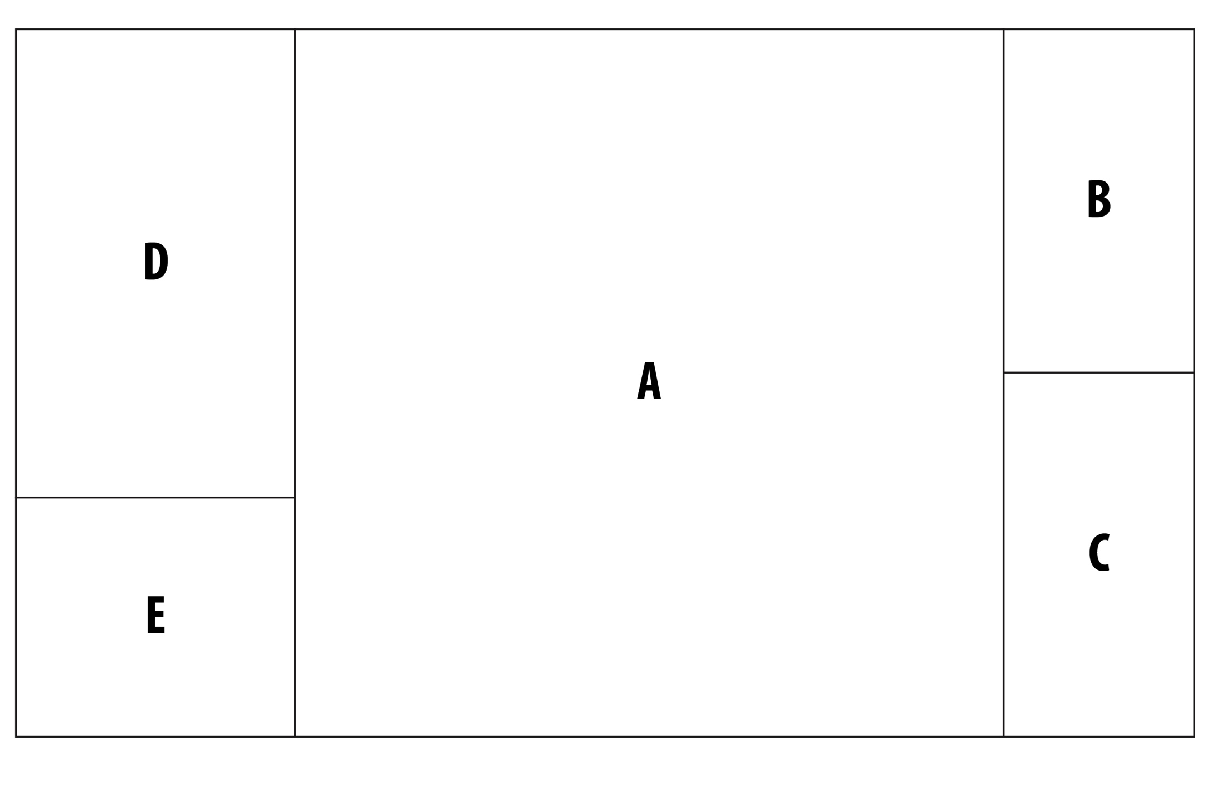
Example Area of Interest

Slide 51
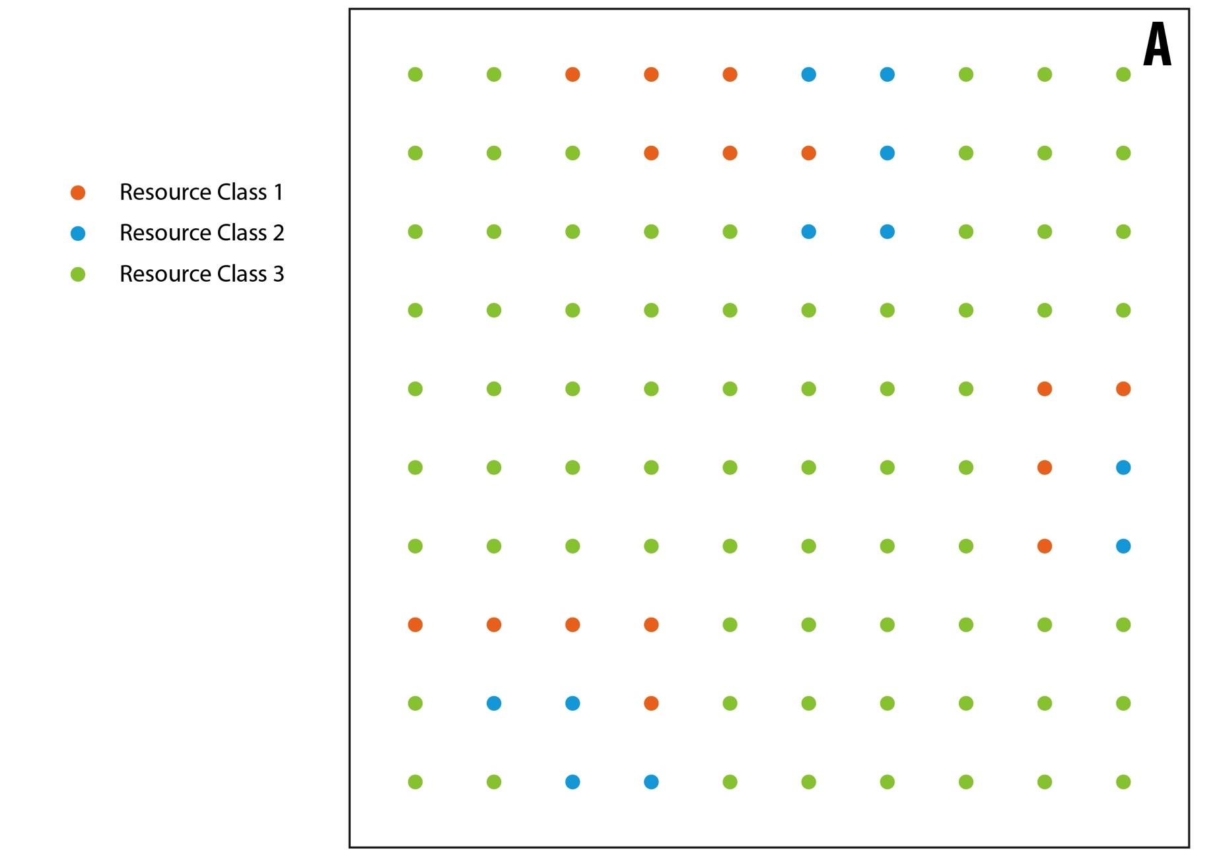
Resource Data Scale

Slide 52
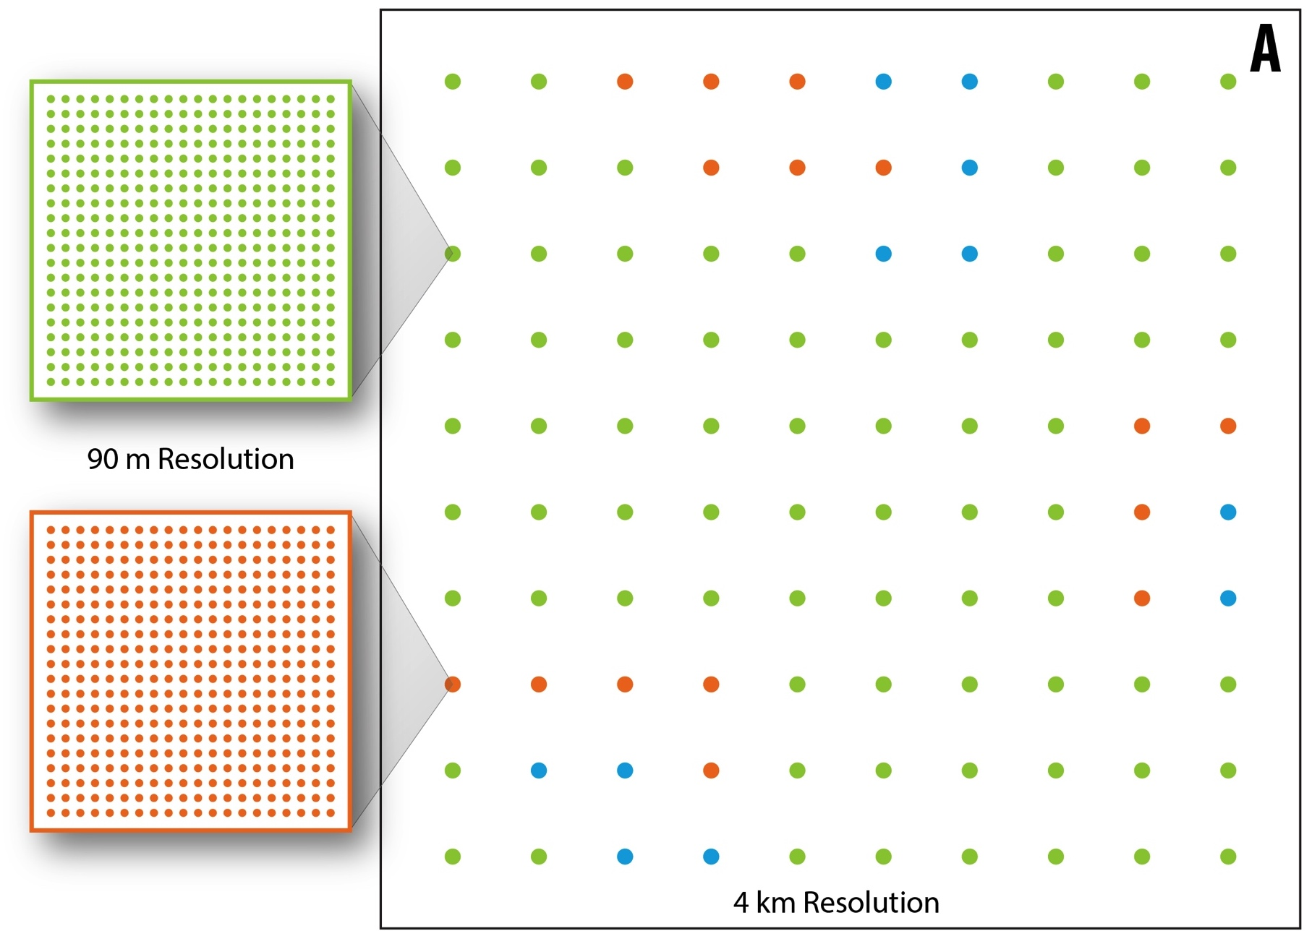
reV Grid and Resource Data Scale

Slide 53
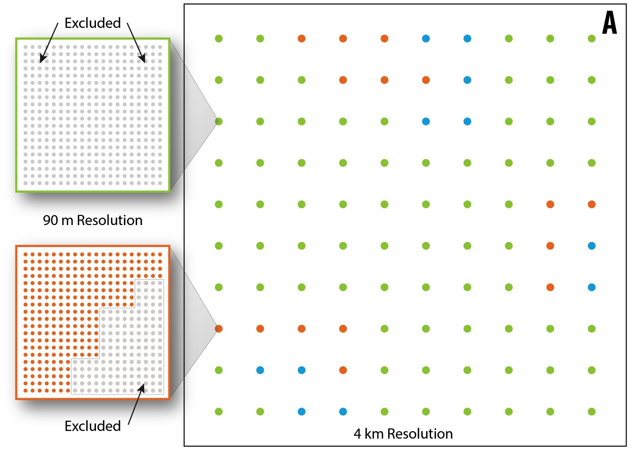
Applying Technical Exclusions

Slide 54
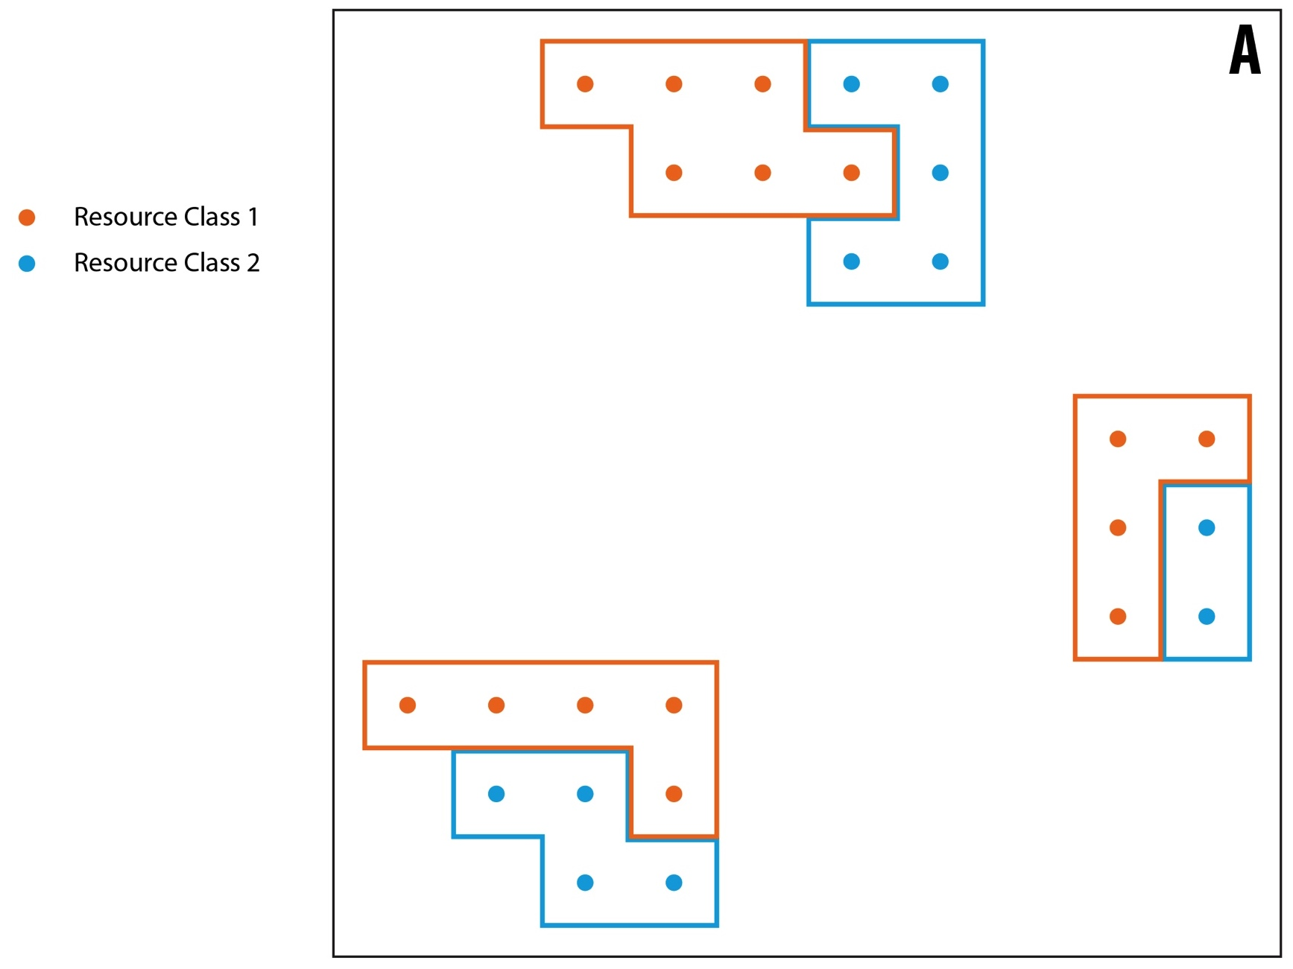
Aggregating to Represent Power Plants

Slide 55
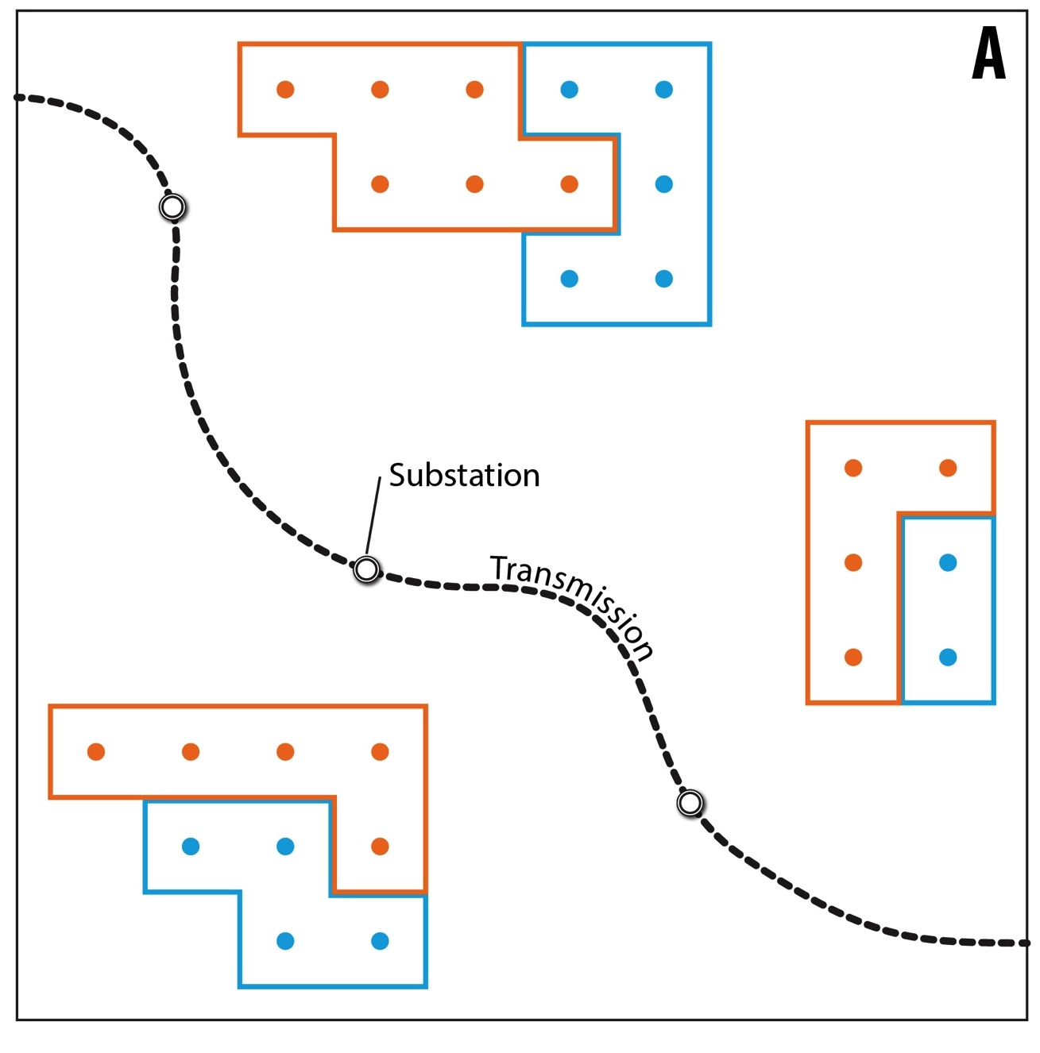
Modeling Grid Interconnection

Slide 56
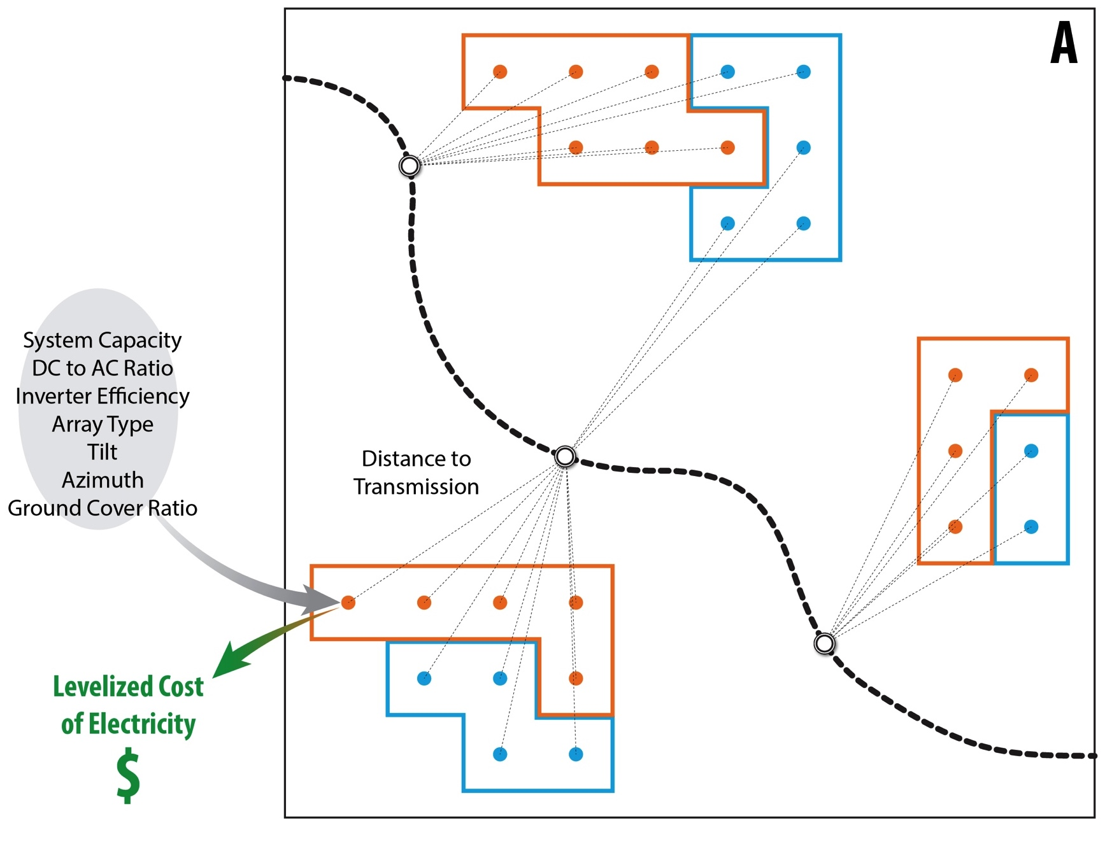
Calculating Techno-Economic Potential

Slide 57
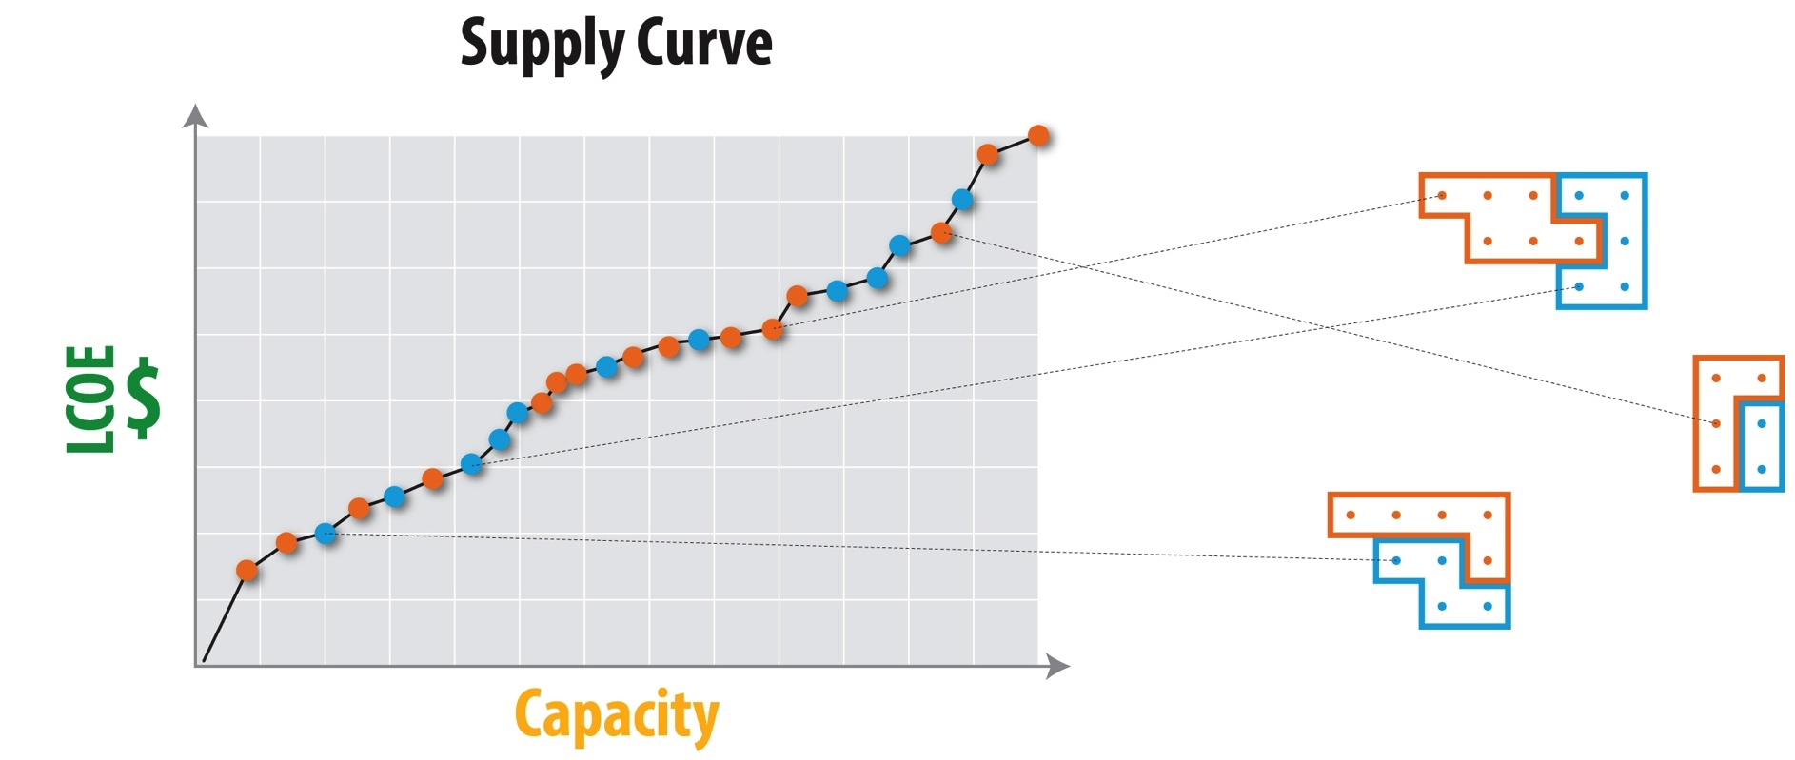
Supply Curve

Slide 58

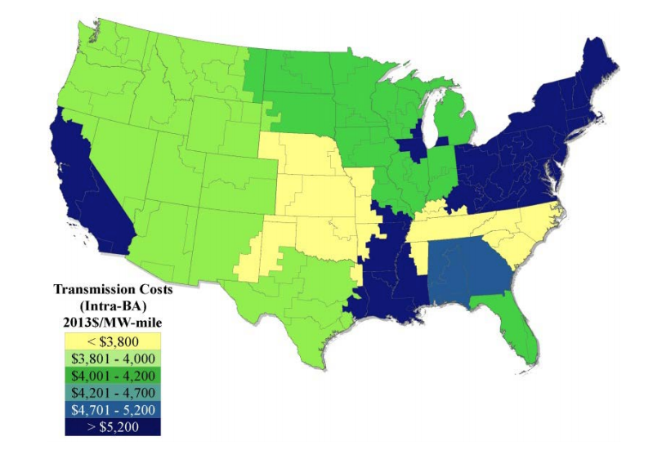
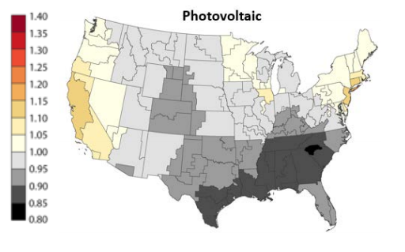
Cost Assumptions
Regional spurline cost multipliers
Regional capital cost multipliers
*Currently sourced from ATB 2020

Slide 59

LCOE / LCOT Calculations
Levelized Cost of Energy
$$LCOE(\$/MWh)= \frac{\left(\left(Capital Cost ∗CCmult\right)∗FCR\right)+FOM}{8760 ∗NCF}$$
Levelized Cost of Transmission
$$Trans Capital Cost(\$/MW)=(Base Trans Cost ∗TRANSmult)∗Miles$$
$$LCOT(\$/MWh)= \frac{Trans Capital Cost ∗FCR}{8760 ∗NCF}$$
Total System Cost ($/MWh) = LCOE + LCOT

Slide 60
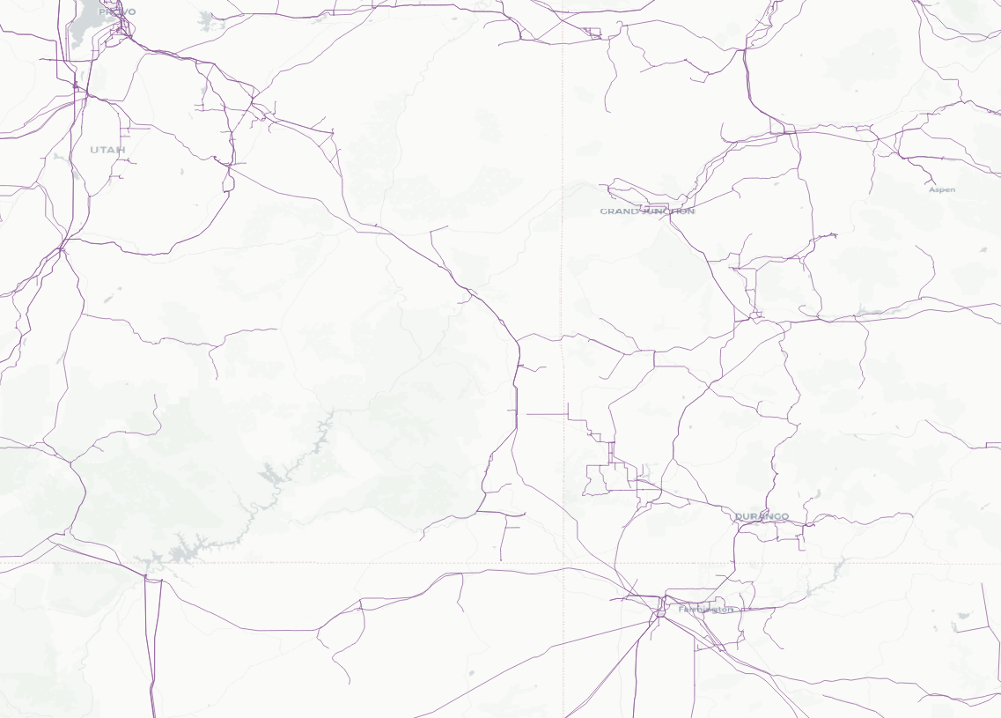

Load Center
Transmission Line
Substation
PV Plant
What is the cheapest point of interconnection?

Slide 61
Spurlines

Slide 62
What is the cheapest option when there are many competing sites?

Slide 63
Total Capacity by Scenario
Scenario | Wind Capacity | Solar Capacity
All Land | 23 TW | 248 TW
Open Access | 15 TW | 179 TW
Reference | 7.8 TW | 104 TW
Limited Access | 2.3 TW | 29 TW

Slide 64
What is the cheapest option when there are many competing sites?

Slide 65
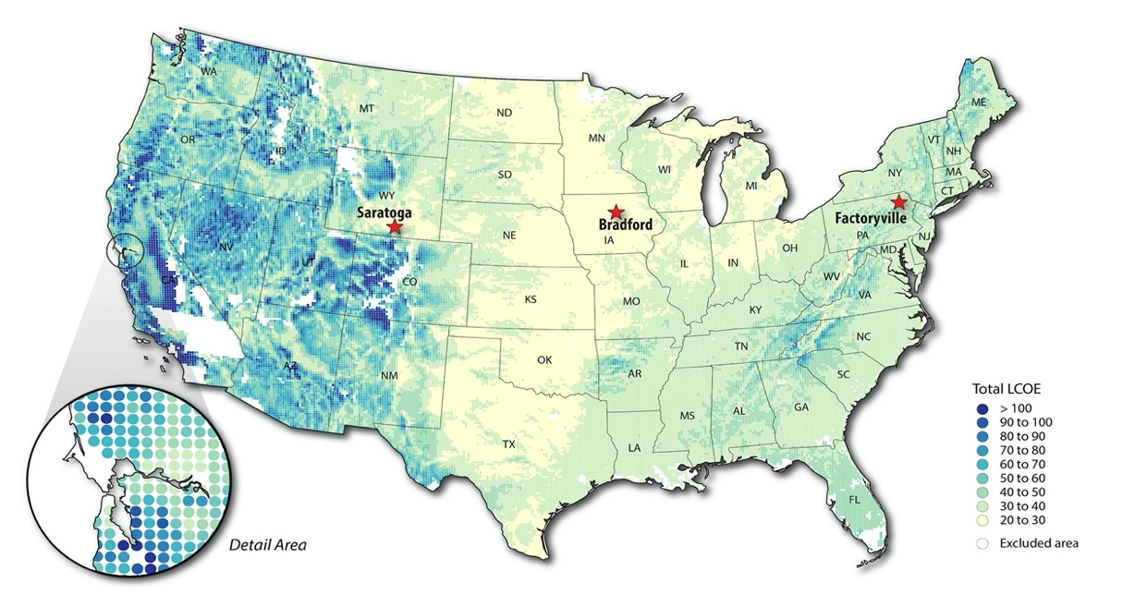
Supply Curve
example
example
example
Each site contributes to the supply curve, with cheapest Total LCOE sites being earlier in the supply curve and more expensive sites being later in the curve
Cheapest Sites
Expensive Sites

